Slide 1
Wellness Wednesday Tax Q&A
Health, Safety, and Work-Life & CG SUPRT
Kenneth Hall, AFC ©, Personal Financial Manager
Kathryn Seymour, AFC ©, Personal Financial Manager
Liana Barakat, CPA©, CG SUPRT Money Coach

Slide 2


Personal Financial Management Program
The Personal Financial Management Program (PFMP) provides access to financial resources, education, training and counseling necessary to empower USCG personnel and their family members to meet personal financial goals, achieve financial security and to remain mission ready.
13 Accredited Financial Counselors ©
CG SUPRT provides free and unlimited Money Coaching
Command Financial Specialists
Program Overview
Home and Car Buying Strategies
Debt Reduction Strategies
Consumer Protection Rights & more
Program Services
Security Clearance Challenges
Budget/Spending Plans
Retirement Planning
Program Directives
  COMDTINST 1740.8 (series) Coast Guard Personal Financial Management Program
  COMDTINST 1740.3 (series) Use of Non-Governmental Educational Materials and Presenters

Slide 3




CG SUPRT Financial Wellness Features
Money Coaching
Digital Tools
Education
Identity Protection & Credit Monitoring
One-on-one confidential coaching around any financial topic
Unlimited access to online learning, resources and tools
cgsuprt.com > Financial
Free online tax filing and assistance (H&R Block)
cgsuprt.com > Free Tax Filing
On-site and on-line financial education classes
Access to credit report, credit score and fraud resolution support

Slide 4
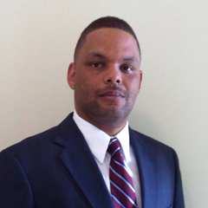


Wellness Wednesday Panel
​
PHOTO
Kenneth Hall, AFC ©
Personal Financial Manager
Kathryn Seymour, AFC ©
Personal Financial Manager
Liana Barakat, CPA ©
CG SUPRT Money Coach
Notes:
Kenneth R. Hall III, AFC®, is the Personal Financial Manager at US Coast Guard Base Boston. He provides services for Northern New Jersey, New York City and the New England Region. Kenneth was a Senior Tax Analyst for H&R Block, Insurance Agent licensed in Life/Medical/Annuities and Long-Term Care and a Mortgage Loan Officer. Kenneth has been a Personal Financial Manager for the Army Community Services at Fort Eustis Army Base, Airman & Family Readiness Center at Langley Air Force Base and Fleet and Family Support Center at Joint Expeditionary Base Little Creek-Fort Story. Kenneth is married with three adult children and a retired Navy veteran with 24 years of active duty service.
Kathryn Seymour-Suffern is a career Civilian, having served with the Department of State, Army, Navy and is currently serving with the USCG, Base National Capital Region, Washington, D.C. as the Personal Financial Manager (PFM). She is an Accredited Financial Counselor®
and a Certified Financial Social Work Educator certified by the Center for Financial Social Work. Ms. Seymour graduated from Wesleyan University, with a B.A. and earned her M.A. from Old Dominion University, Norfolk, VA. Kathryn is an USCG Spouse and has four children Brennan (20)CGA ‘21, MacKenzie (17), John (17) & Gabriella (14).
Liana Barakat is a CG SUPRT Senior Money Coach – Tax Specialist. Tax planning and support are her favorite areas to assist members. As a Certified Public Account (CPA), she enjoys helping people find clarity and gain a deeper understanding about their tax situations and strategies. Ms. Barakat began my career in the accounting profession in 2016, and hold a Bachelor's and Master's degree in accounting. Every conversation with every member is important to me and I want to make sure each member is able to make informed decisions for their particular situation. I find it rewarding to share information and knowledge about tax topics with members that ultimately inspires confidence in themselves to achieve their tax planning goals.

Slide 5
Agenda
Getting Organized- What Documents to Gather
Recent Tax Changes / Laws
Cryptocurrency
Tax Scams: What to Know
Tax Credits
Withholdings/Standard Deduction/Tax Brackets
Retirement Contribution Limits
Where to find assistance? Armed Forces Tax Publication
Q & A

Slide 6
What Documents to Gather
Personal Identification Information on all filers and dependents
Bank account and routing # to receive direct deposit
All Sources of Income (W-2s, 1099s, K-1, Alimony received, Business Income/ Expenses, Cancellation of Debt, etc.)
Itemization and Tax Credit information (Medical and Dental expenses, Mortgage and Property Tax Info, Contribution Information to HSA, IRA, SEP, Adoption Costs, Child Care Costs, and Higher Ed. Expenses)

Slide 7
Recent Tax Changes
1099 K - Some Taxpayers may receive 1099K
Third Party Payments - Form 1099-K, Payment Card and Third-Party Network Transactions is an IRS form used to report credit/debit card transactions and third-party network payments
Self Employment - If self-employed or work as an independent contractor, then typically report your income, including that from forms 1099-K, on Schedule C of your Form 1040
Business Expenses - You can use other ordinary and necessary business expenses incurred in your business activity to offset the income
Net Profit - The net profit will be subject to income tax and self-employment tax

Slide 8
Cryptocurrency
Cryptocurrency - treated as property - capital gains/losses reported on Schedule D
Cryptocurrency records of transactions (Profit / Loss) - Form 1099-B
Possible $3,000 offset - if exceed your capital gains for the tax year, you can apply up to $3,000 ($1,500 for MFS) of the capital loss to offset other income when you file. Any remaining excess capital loss is carried forward

Slide 9
Cryptocurrency (cont.)
Keep track of how much you gained or lost in U.S. dollars
Short term investment (Held 1 Year or Less) / Long Term investment (Greater than 1 year) Capital Gains Tax Rates – Short Term taxed as ordinary income. Long Term taxed at 0, 15 or 20%

Slide 10
Tax Scams
Tax scams are especially aggressive during tax season
The IRS will never call you
The IRS does not initiate contact with taxpayers by email, text messages or social media channels to request personal or financial information
The IRS will not demand immediate payment via a specific payment method, such as a debit card or wire transfer
Report any attempts of scamming to IRS

Slide 11
Tax Credits
Child Tax Credit - credit of up to $2,000 per child under age 17
Earned Income Tax Credit : must meet certain adjusted gross income (AGI) and credit limits for the current, previous and upcoming tax years ( IRS.gov/EITC)
Child and Dependent Care Credit – credit of up to $3,000 if you have one qualifying person, or $6,000 if you have two or more qualifying persons; Maximum credit is 35% of your employment-related expenses
American Opportunity Tax Credit – up to $2,500 per student
Lifetime Learning Credit ( LLC)- up to $2,000 per return

Slide 12
Saver’s Credit
2022
2023
Credit Rate | Married Filing Jointly | Head of Household | All Other Filers*
50% of your contribution | AGI not more than $41,000 | AGI not more than $30,750 | AGI not more than $20,500
20% of your contribution | $41,001- $44,000 | $30,751 - $33,000 | $20,501 - $22,000
10% of your contribution | $44,001 - $68,000 | $33,001 - $51,000 | $22,001 - $34,000
0% of your contribution | more than $68,000 | more than $51,000 | more than $34,000
Credit Rate | Married Filing Jointly | Head of Household | All Other Filers*
50% of your contribution | AGI not more than $43,500 | AGI not more than $32,625 | AGI not more than $21,750
20% of your contribution | $43,501- $47,500 | $32,626 - $35,625 | $21,751 - $23,750
10% of your contribution | $47,501 - $73,000 | $35,626 - $54,750 | $23,751 - $36,500
0% of your contribution | more than $73,000 | more than $54,750 | more than $36,500
*Single, married filing separately, or qualifying widow(er)

Slide 13
Withholdings
Adjust your W-4 if needed (Additional dependents)
Check your Pay Slip to make sure correct amount taken out
IRS Tax Withholding Calculator
  Capture all expected income: Bonus, Spouse outside employment
  https://apps.irs.gov/app/tax-withholding-estimator

Slide 14
2022 Standard Deduction Amounts
Filing Status | 2022 Standard Deduction | 2023 Standard Deduction
Single; Married Filing Separately | $12,950 | $13,850
Married Filing Jointly; Qualifying Widow(er) | $25,900 | $27,700
Head of Household | $19,400 | $20,800

Slide 15
Itemized Deductions
Deductions may include:
    Medical and Dental Expenses
    State and Local Income Taxes
    Home Mortgage Interest Paid
    Charitable Donations
    Casualty and Theft Losses

Slide 16
2022 Tax Brackets
for Single/Married Filing Jointly/Head of Household
Tax Rate | Taxable Income (Single) | Taxable Income (Married Filing Jointly) | Taxable Income (Head of Household)
10% | Up to $10,275 | Up to $20,550 | Up to $14,650
12% | $10,276 to $41,775 | $20,551 to $83,550 | $14,651 to $55,900
22% | $41,776 to $89,075 | $83,551 to $178,150 | $55,901 to $89,050
24% | $89,076 to $170,050 | $178,151 to $340,100 | $89,051 to $170,050
32% | $170,051 to $215,950 | $340,101 to $431,900 | $170,051 to $215,950
35% | $215,951 to $539,900 | $431,901 to $647,850 | $215,951 to $539,900
37% | Over $539,900 | Over $647,850 | Over $539,900

Slide 17
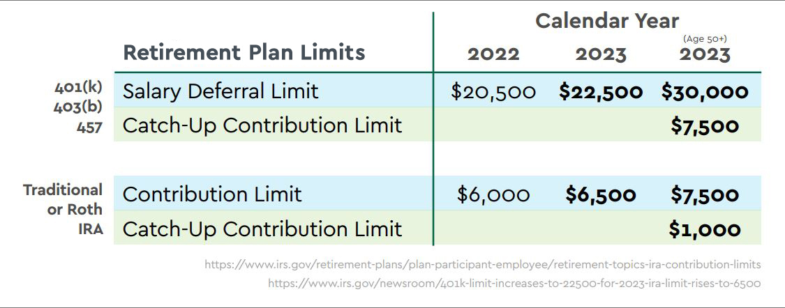
Retirement Contribution Limits
Aggregation Rules:
Contributions to 401(k) and 403(b) are aggregated for a total of $22,500 ($30,000 with Catch-Up)
Contributions to 457 Plans are separate and are not aggregated with other Retirement Plans
Contributions to IRAs (Traditional and Roth) are aggregated for a total of $6,500 ($7,500 with Catch-Up)
Note: These contribution limits are employee contributions only; employer match is not included in these amounts

Slide 18
Where to Go for Assistance?
Armed Forces Tax Publication 3
IRS Free File
IRS Resources Page
CG SUPRT offers free online state and federal tax filing through H&R Block online. (Must be accessed through the CG SUPRT website or click the link in the chat)
CG SUPRT Money Coach, CPA, Enrolled Agent
Nearest Legal Assistance Office
Notes:
About Publication 3, Armed Forces' Tax Guide | Internal Revenue Service (irs.gov)
Free File: Do your Federal Taxes for Free | Internal Revenue Service (irs.gov)
Resources to Help You Prepare Your Tax Return and Resolve Tax Disputes | Internal Revenue Service (irs.gov)

Slide 19





Closing and Resources
CFS
PFM
Money Coach
Command Financial Specialist (CFS)
Units’ point of contact for financial resources
Personal Financial Manager (PFM)
Designated subject matter experts in all areas of personal finance
Money Coach
Telephone availability through CGSUPRT with unlimited 30-minute phone consultations
To make an appointment with a Money Coach:
Online
cgsuprt.mysecureadvantage.com
1-855-CG SUPRT (247-8778)
Hours: Mon – Fri, 6AM – 5PM PT
Phone

